Slide 1
Exception Handling

Slide 2
Program Errors
Syntax (compiler) errors
  Errors in code construction (grammar, types)
  Detected during compilation
Run-time errors
  Operations illegal / impossible to execute
  Detected during program execution
  Treated as exceptions in Java
Logic errors
  Operations leading to incorrect program state
  May (or may not) lead to run-time errors
  Detect by debugging code
1

Slide 3
Exception-Handling Fundamentals
An exception is an abnormal condition that arises in a code sequence at run time
A Java exception is an object that describes an exceptional condition that has occurred in a piece of code
When an exceptional condition arises, an object representing that exception is created and thrown in the method that caused the error
An exception can be caught to handle it or pass it on
Exceptions can be generated by the Java run-time system, or they can be manually generated by your code

Slide 4
What are Exceptions?
Many “exceptional” things can happen during the running of a program, e.g.:
User mis-types input
checked
Web page not available
File not found
Array index out of bounds
unchecked
Method called on a null object
Divide by zero
Out of memory
sys errors
Bug in the actual language implementation
Exceptions are unexpected conditions in programs.

Slide 5
We can distinguish 3 categories:
checked exceptions — Problems to do with the program's interaction with “the world”.
unchecked exceptions — Problems within the program itself (i.e. violations of the contract, or bugs).
The world is unpredictable, so we would expect these things to happen in production code, and so need to handle them.
system errors — Problems with the underlying system. These are outside our control.
These should be removed by testing, and not occur in production code.
The World
Checked Exceptions
Unchecked Exceptions
Program
System Errors
System

Slide 6
Checked vs Unchecked Exceptions
an important distinction, which the Java Exception class hierarchy does make, but in a rather confusing way
it's normal to let these just crash the program so we can debug it.
we would normally check for these, and deal with them when they occur.
The World
Checked Exceptions
Unchecked Exceptions
Program
System
System Errors
Exception handling is the business of handling these things appropriately.

Slide 7
Exception Handling
Performing action in response to exception
Examples
  Exit program (abort)
  Ignore exception
  Deal with exception and continue
    Print error message
    Request new data
    Retry action

Slide 8
Exception Handling – Exit Program
Approach
  Exit program with error message / error code
Example
  if (error) {
  System.err.println(“Error found”); // message
  System.exit(1); // error code
  }
Problem
  Drastic solution
  Event must be handled by user invoking program
  Program may be able to deal with some exceptions

Slide 9
Exception Handling – Error Code
Approach
  Exit function with return value ⇒ error code
Example
  A( ) { if (error) return (-1); }
  B( ) { if ((retval = A( )) == -1) return (-1); }
Problems
  Calling function must check & process error code
    May forget to handle error code
    May need to return error code to caller
  Agreement needed on meaning of error code
  Error handling code mixed with normal code

Slide 10
Exception Handling – Throw Exception
Approach
  Throw exception
Example
  A( ) {
  if (error) throw new ExceptionType();
  }
  B( ) {
  try {
  A( );
  }
  catch (ExceptionType e) { ...action... }
  }
Java exception backtracks to caller(s) until matching catch block found

Slide 11
Exception Handling – Throw Exception
Advantages
  Compiler ensures exceptions are caught eventually
  No need to explicitly propagate exception to caller
    Backtrack to caller(s) automatically
  Class hierarchy defines meaning of exceptions
    No need for separate definition of error codes
  Exception handling code separate & clearly marked

Slide 12
Exception-Handling Fundamentals
Java exception handling is managed by via five keywords: try, catch, throw, throws, and finally
Program statements to monitor are contained within a try block
If an exception occurs within the try block, it is thrown
Code within catch block catch the exception and handle it
System generated exceptions are automatically thrown by the Java run-time system
To manually throw an exception, use the keyword throw
Any exception that is thrown out of a method must be specified as such by a throws clause

Slide 13
Using try and catch
Handling an exception has two benefits,
  It allows you to fix the error
  It prevents the program from automatically terminating
The catch clause should follow immediately the try block
Once an exception is thrown, program control transfer out of the try block into the catch block
Once the catch statement has executed, program control continues with the next line in the program following the entire try/catch mechanism

Slide 14
Exception-Handling Fundamentals
Any code that absolutely must be executed before a method returns is put in a finally block
General form of an exception-handling block
try{
// block of code to monitor for errors
}
catch (ExceptionType1 exOb){
// exception handler for ExceptionType1
}
catch (ExceptionType2 exOb){
// exception handler for ExceptionType2
}
//…
finally{
// block of code to be executed before try block ends
}

Slide 15
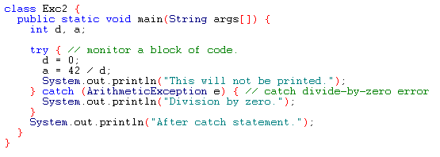
Example
Output:
Division by zero.
After catch statement.

Slide 16
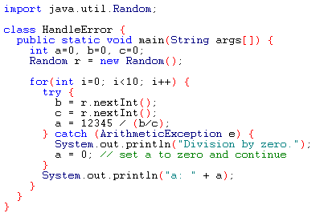
Using try and catch
A try and catch statement form a unit. The scope of the catch clause is restricted to those statements specified by the immediately preceding try statement

Slide 17
Uncaught Exceptions
If an exception is not caught by user program, then execution of the program stops and it is caught by the default handler provided by the Java run-time system
Default handler prints a stack trace from the point at which the exception occurred, and terminates the program
Ex:
class Exc0 {
public static void main(String args[]) {
int d = 0;
int a = 42 / d;
}
}
Output:
java.lang.ArithmeticException: / by zero
at Exc0.main(Exc0.java:4)
Exception in thread "main"

Slide 18
Multiple catch Clauses
If more than one can occur, then we use multiple catch clauses
When an exception is thrown, each catch statement is inspected in order, and the first one whose type matches that of the exception is executed
After one catch statement executes, the others are bypassed

Slide 19
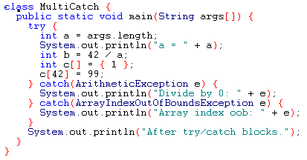
Example

Slide 20
Example (Cont.)
If no command line argument is provided, then you will see the following output:
  a = 0
  Divide by 0: java.lang.ArithmeticException: / by zero
  After try/catch blocks
If any command line argument is provided, then you will see the following output:
  a = 1
  Array index oob: java.lang.ArrayIndexOutOfBoundsException
  After try/catch blocks.

Slide 21
Example
public class Etest {
public static void main(String args[]){
// What we expect to happen
try {
int x = Integer.parseInt(args[0]);
int y = Integer.parseInt(args[1]);
System.out.println( x + "/" + y + " = " + x/y ); }
// Things which can go wrong
catch (IndexOutOfBoundsException e) {
System.out.println( "Usage: Etest <int> <int>" ); }
catch (NumberFormatException e) {
System.out.println( e.getMessage() + " is not a number" ); }
// Do this regardless
finally {
System.out.println( "That's all, folks" ); }
} // main
} // Etest

Slide 22
public class Etest {
public static void main(String args[]){
// What we expect to happen
try {
int x = Integer.parseInt(args[0]);
int y = Integer.parseInt(args[1]);
System.out.println( x + "/" + y + " = " + x/y ); }
// Things which can go wrong
catch (IndexOutOfBoundsException e) {
System.out.println( "Usage: Etest <int> <int>" ); }
catch (NumberFormatException e) {
System.out.println( e.getMessage() + " is not a number" ); }
// Do this regardless
finally {
System.out.println( "That's all, folks" ); }
} // main
} // Etest
> java Etest 99 42
99/42 = 2
That's all, folks

Slide 23
public class Etest {
public static void main(String args[]){
// What we expect to happen
try {
int x = Integer.parseInt(args[0]);
int y = Integer.parseInt(args[1]);
System.out.println( x + "/" + y + " = " + x/y ); }
// Things which can go wrong
catch (IndexOutOfBoundsException e) {
System.out.println( "Usage: Etest <int> <int>" ); }
catch (NumberFormatException e) {
System.out.println( e.getMessage() + " is not a number" ); }
// Do this regardless
finally {
System.out.println( "That's all, folks" ); }
} // main
} // Etest
> java Etest 99
Usage: Etest <int> <int>
That's all, folks

Slide 24
public class Etest {
public static void main(String args[]){
// What we expect to happen
try {
int x = Integer.parseInt(args[0]);
int y = Integer.parseInt(args[1]);
System.out.println( x + "/" + y + " = " + x/y ); }
// Things which can go wrong
catch (IndexOutOfBoundsException e) {
System.out.println( "Usage: Etest <int> <int>" ); }
catch (NumberFormatException e) {
System.out.println( e.getMessage() + " is not a number" ); }
// Do this regardless
finally {
System.out.println( "That's all, folks" ); }
} // main
} // Etest
> java Etest 99 fred
fred is not a number
That's all, folks

Slide 25
public class Etest {
public static void main(String args[]){
// What we expect to happen
try {
int x = Integer.parseInt(args[0]);
int y = Integer.parseInt(args[1]);
System.out.println( x + "/" + y + " = " + x/y ); }
// Things which can go wrong
catch (IndexOutOfBoundsException e) {
System.out.println( "Usage: Etest <int> <int>" ); }
catch (NumberFormatException e) {
System.out.println( e.getMessage() + " is not a number" ); }
// Do this regardless
finally {
System.out.println( "That's all, folks" ); }
} // main
} // Etest
> java Etest fred
fred is not a number
That's all, folks

Slide 26
public class Etest {
public static void main(String args[]){
// What we expect to happen
try {
int x = Integer.parseInt(args[0]);
int y = Integer.parseInt(args[1]);
System.out.println( x + "/" + y + " = " + x/y ); }
// Things which can go wrong
catch (IndexOutOfBoundsException e) {
System.out.println( "Usage: Etest <int> <int>" ); }
catch (NumberFormatException e) {
System.out.println( e.getMessage() + " is not a number" ); }
// Do this regardless
finally {
System.out.println( "That's all, folks" ); }
} // main
> java Etest 99 0
} // Etest
That's all, folks
java.lang.ArithmeticException: / by zero at Etest.main(Etest.java:8)

Slide 27
Using finally for Cleanup
Finalizers aren't much good for releasing resources
To get guaranteed cleanup of network connections etc. use finally clauses, e.g.:
because we don't know when (or even if) they will be called
Socket s;
InputStream in;
try {
s = new Socket(...);
...
in = s.getInputStream();
...
}
catch (IOException e) {...}
finally {
finally {
if (in != null) in.close());
try {
if (in != null) in.close());
s.close();
}
s.close();
}
catch (IOException e){}
But there's a snag — the call to in.close() may itself throw an exception
}
So we actually need a try ... catch block within the finally clause
e.g. if the network goes down at the wrong moment

Slide 28
With Exception Handling - Example
class WithExceptionCatchThrow{
public static void main(String[] args){
int a,b; float r; a = 7; b = 0;
try{
r = a/b;
System.out.println(“Result is “ + r);
}
catch(ArithmeticException e){
System.out.println(“ B is zero);
throw e;
}
System.out.println(“Program is complete”);
}
}
Program Does Not
reach here
when exception occurs

Slide 29
With Exception Handling - Example
class WithExceptionCatchThrowFinally{
public static void main(String[] args){
int a,b; float r; a = 7; b = 0;
try{
r = a/b;
System.out.println(“Result is “ + r);
}
catch(ArithmeticException e){
System.out.println(“ B is zero);
}
finally{
System.out.println(“Program is complete”);
}
}
}
Program reaches here

Slide 30
Exception Types
All exception types are subclasses of the built-in class Throwable
Throwable has two subclasses, they are
  Exception (to handle exceptional conditions that user programs should catch)
    An important subclass of Exception is RuntimeException, that includes division by zero and invalid array indexing
  Error (to handle exceptional conditions that are not expected to be caught under normal circumstances). i.e. stack overflow

Slide 31
Exception Hierarchy in Java
Throwable
Error
Exception
RunTimeException
. . .
Exception − RunTimeException
The World
Checked Exceptions
RunTimeException
Unchecked Exceptions
Program
Error
System Errors
System

Slide 32
Representing Exceptions
Exceptions represented as
  Objects derived from class Throwable
Code
  public class Throwable( ) extends Object {
  Throwable( ) // No error message
  Throwable( String mesg ) // Error message
  String getMessage() // Return error mesg
  void printStackTrace( ) { … } // Record methods
  … // called & location
  }

Slide 33
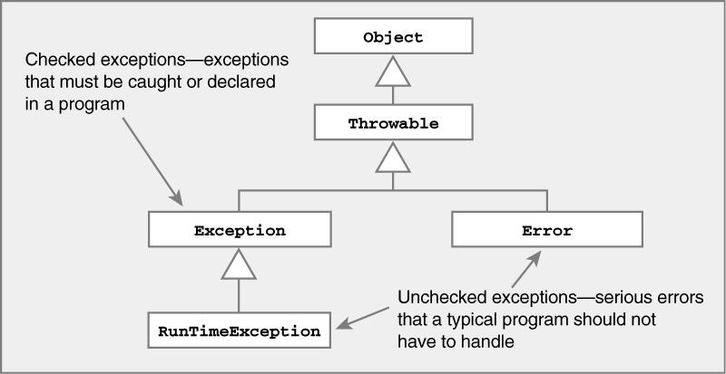
Representing Exceptions
Java Exception class hierarchy
  Two types of exceptions ⇒ checked & unchecked

Slide 34
Representing Exceptions
Java Exception class hierarchy
ClassNotFoundException
Exception
CloneNotSupportedException
IOException
ArithmeticException
AWTException
NullPointerException
RuntimeException
Object
Throwable
IndexOutOfBoundsException
…
NoSuchElementException
LinkageError
…
VirtualMachoneError
Error
AWTError
Checked
…
Unchecked

Slide 35
EXCEPTION VS. ERROR
An Error indicates a serious problem that a reasonable application should not try to catch.
Examples:
  ClassFormatError,
  InstantiationError,
  InternalError,
  NoSuchMethodError,
  OutOfMemoryError,
  StackOverflowError,
  VirtualMachineError.

Slide 36
RuntimeException
RuntimeException is the superclass of those exceptions that can be thrown during the normal operation of the JVM.
Examples:
  NullPointerException,
  ArrayIndexOutOfBoundsException,
  NegativeArraySizeException,
  ClassCastException,
  NumberFormatException,
  SecurityException.

Slide 37
Caution
Remember that, exception subclass must come before any of of their superclasses
Because, a catch statement that uses a superclass will catch exceptions of that type plus any of its subclasses. So, the subclass would never be reached if it come after its superclass
For example, ArithmeticException is a subclass of Exception
Moreover, unreachable code in Java generates error

Slide 38
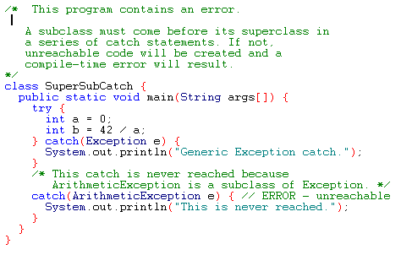
Example

Slide 39
Nested try Statements
A try statement can be inside the block of another try
Each time a try statement is entered, the context of that exception is pushed on the stack
If an inner try statement does not have a catch, then the next try statement’s catch handlers are inspected for a match
If a method call within a try block has try block within it, then it is still nested try

Slide 40
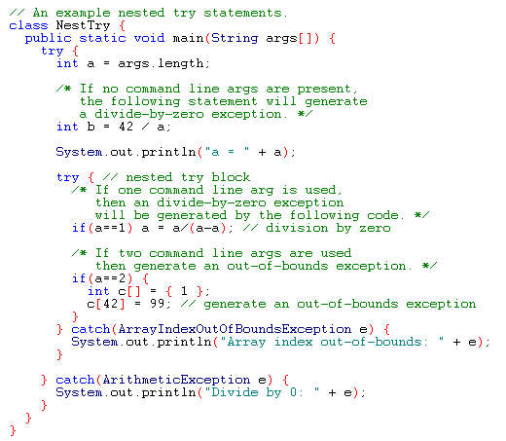
Example

Slide 41
Output
When no parameter is given:
  Divide by 0: java.lang.ArithmeticException: / by zero
When one parameter is given
a = 1
Divide by 0: java.lang.ArithmeticException: / by zero
When two parameters are given
  a = 2
  Array index out-of-bounds: java.lang.ArrayIndexOutOfBoundsException

Slide 42
throw
It is possible for your program to to throw an exception explicitly
throw TrrowableInstance
Here, TrrowableInstance must be an object of type Throwable or a subclass Throwable
There are two ways to obtain a Throwable objects:
  Using a parameter into a catch clause
  Creating one with the new operator

Slide 43
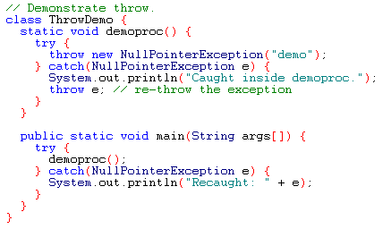
Example
Output:
Caught inside demoproc.
Recaught: java.lang.NullPointerException: demo

Slide 44
throws
If a method is capable of causing an exception that it does not handle, it must specify this behavior so that callers of the method can guard themselves against that exception
  type method-name parameter-list) throws exception-list
  {
  // body of method
  }
It is not applicable for Error or RuntimeException, or any of their subclasses

Slide 45
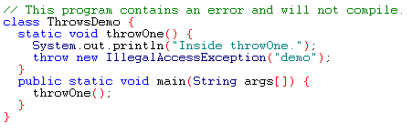
Example: incorrect program

Slide 46
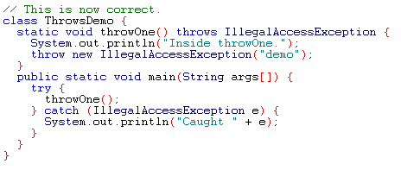
Example: corrected version
Output:
Inside throwOne.
Caught java.lang.IllegalAccessException: demo

Slide 47
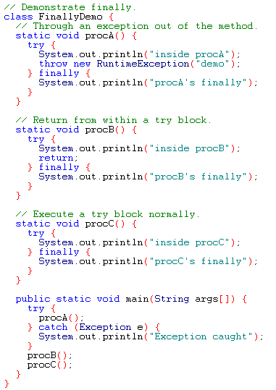
Example

Slide 48
Output
inside procA
procA's finally
Exception caught
inside procB
procB's finally
inside procC
procC's finally

Slide 49
User-Defined Exceptions
Problem Statement :
  Consider the example of the Circle class
  Circle class had the following constructor
public Circle(double centreX, double centreY,
double radius){
x = centreX; y = centreY; r = radius;
}
  How would we ensure that the radius is not zero or negative?
  Circle

Slide 50
Defining your own exceptions
import java.lang.Exception;
class InvalidRadiusException extends Exception {
private double r;
public InvalidRadiusException(double radius){
r = radius;
}
public void printError(){
System.out.println("Radius [" + r + "] is not valid");
}
}

Slide 51
Throwing the exception
class Circle {
double x, y, r;
public Circle (double centreX, double centreY, double radius ) throws InvalidRadiusException {
if (r <= 0 ) {
throw new InvalidRadiusException(radius);
}
else {
x = centreX ; y = centreY; r = radius;
}
}
}

Slide 52
Catching the exception
class CircleTest {
public static void main(String[] args){
try{
Circle c1 = new Circle(10, 10, -1);
System.out.println("Circle created");
}
catch(InvalidRadiusException e)
{
e.printError();
}
}
}

Slide 53
User-Defined Exceptions in standard format
class MyException extends Exception
{
  MyException(String message)
  {
    super(message); // pass to superclass if parameter is not handled by used defined exception
  }
}
class TestMyException {
…
try {
  ..
  throw new MyException(“This is error message”);
  }
  catch(MyException e)
  {
    System.out.println(“Message is: “+e.getMessage());
  }
}
}
Get Message is a method defined in a standard
Exception class.

Slide 54
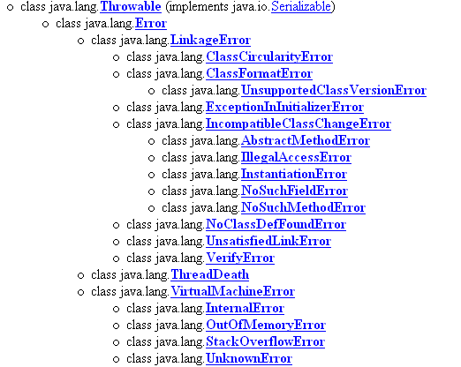
Java’s Built-in Errors
Small letter indicate package name
Capital letter indicate class name

Slide 55
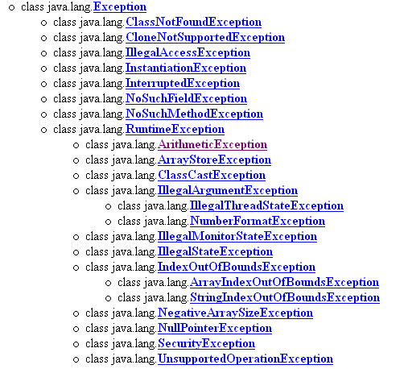
Java’s Built-in Exceptions

